Slide 1
AD Issue

Slide 2
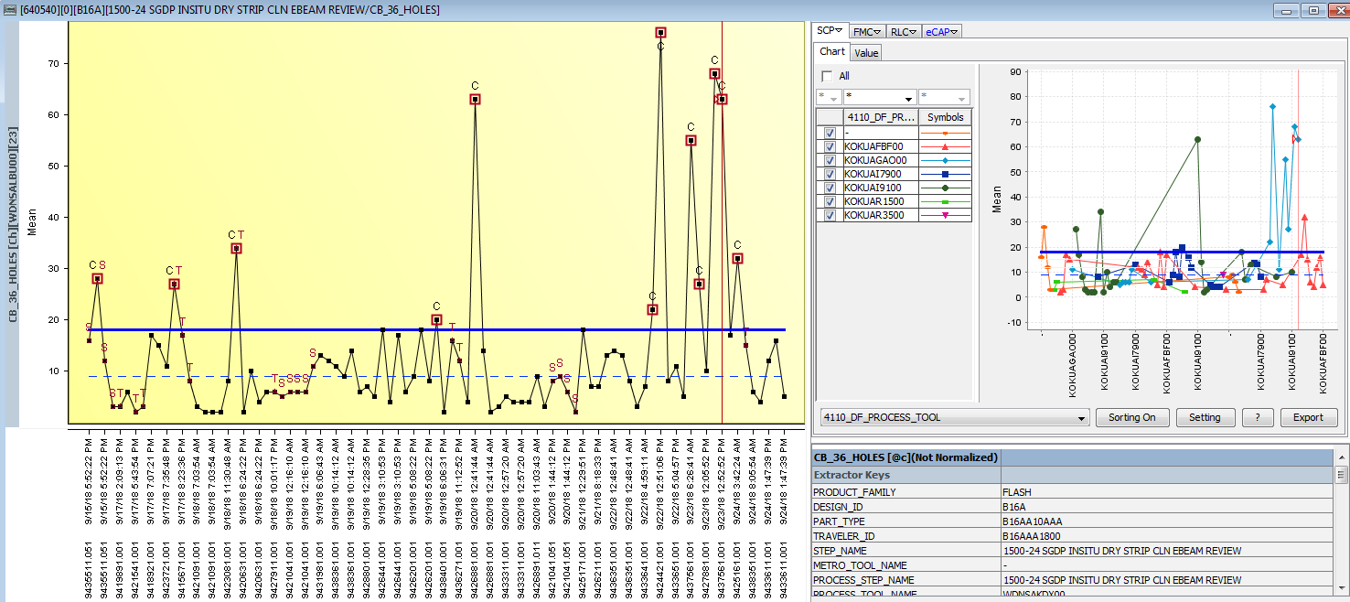
9/23 session AD did not flag GAO
4110-24 SGDP NITRIDE DEP - KOKUAGAO00

Slide 3
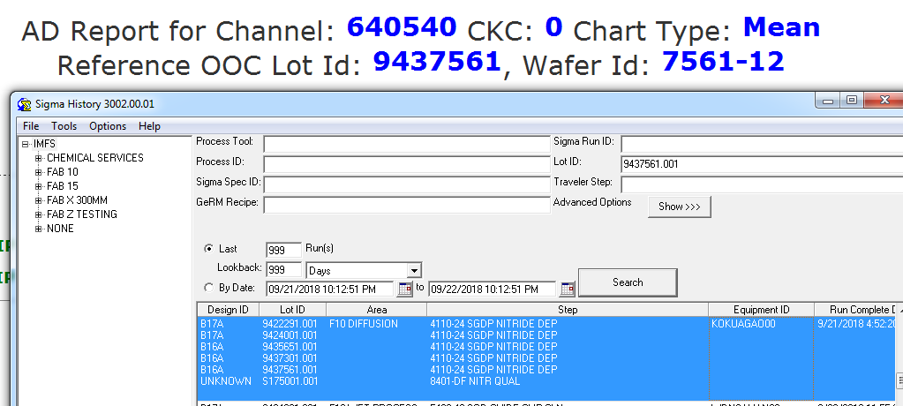

Slide 4
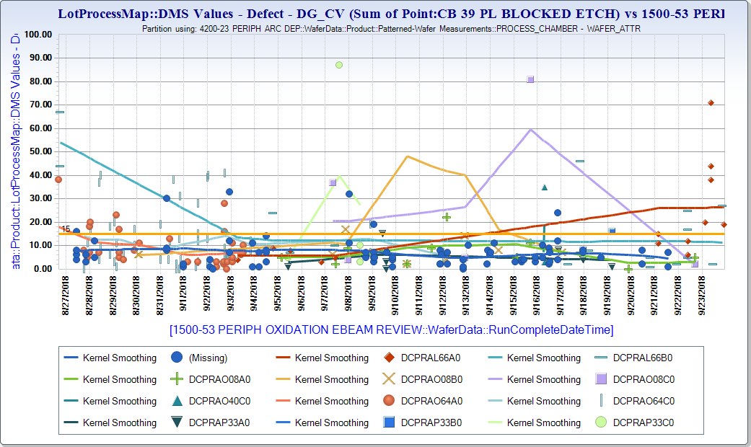
F10N 9/23,9/24 did not flag L66A0 as root cause

Slide 5
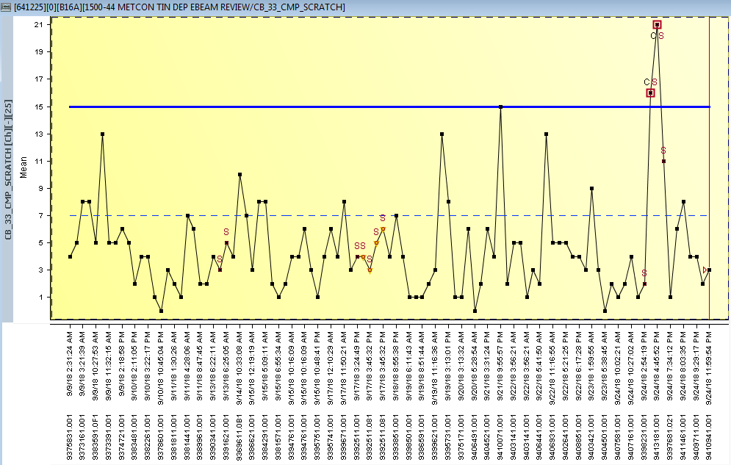
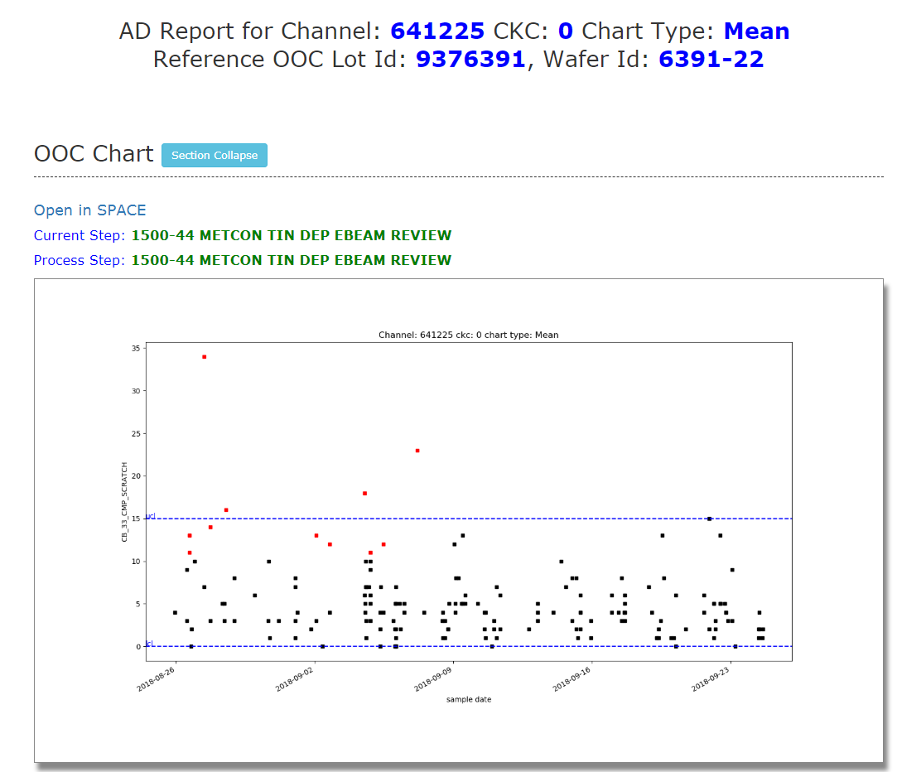
2 data points missing in AD report
This lot is OOC on 9/2
http://fslhdppds01/rda_ad/2018-09-24/10_641225_0_Mean_2018092420.html

Slide 6
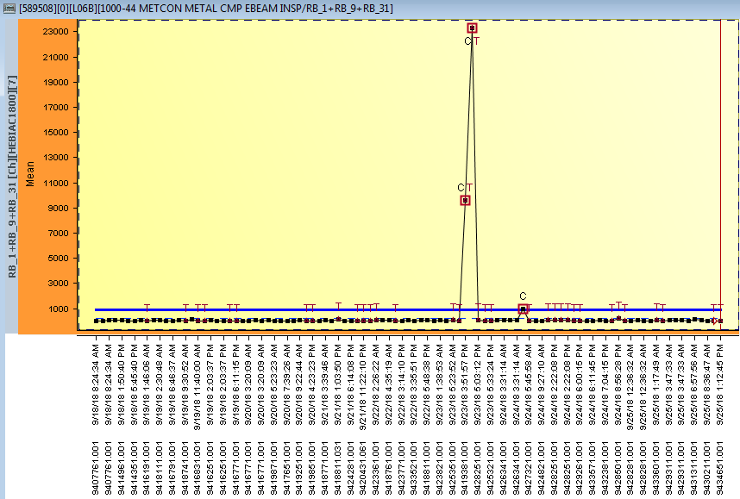
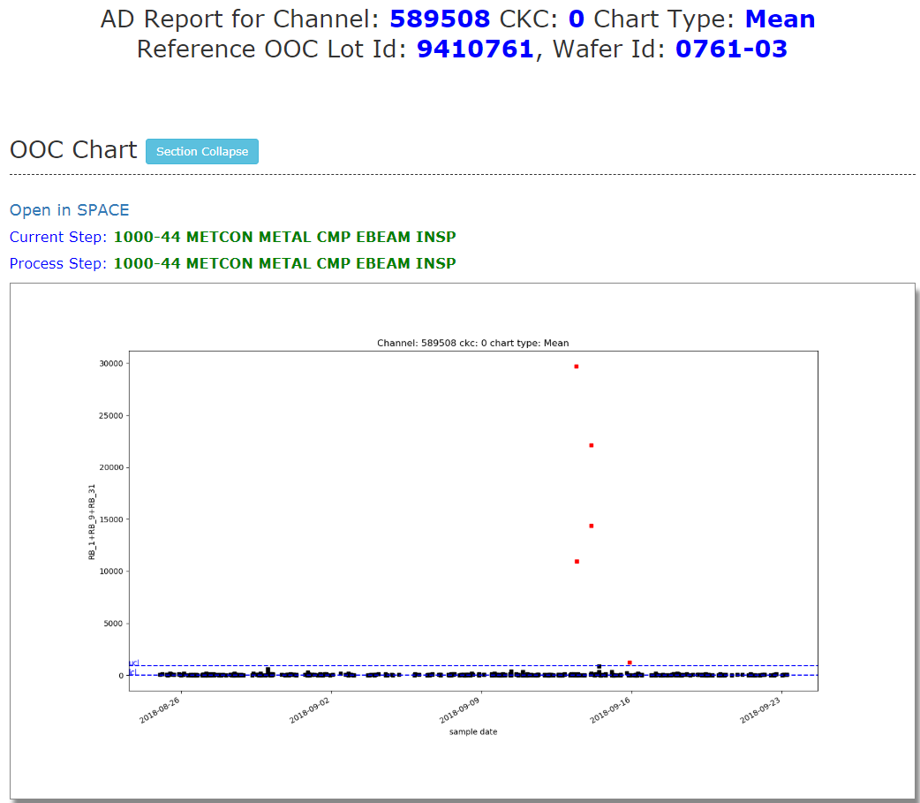
2 data points missing in AD report
This lot is OOC on 9/15
https://tableau-apac/#/site/F10FEMFG/views/F10_QM69A_V2_RDA_OOC_SUMMARY/DailyADTriggerDashboard?:iid=1

Slide 7
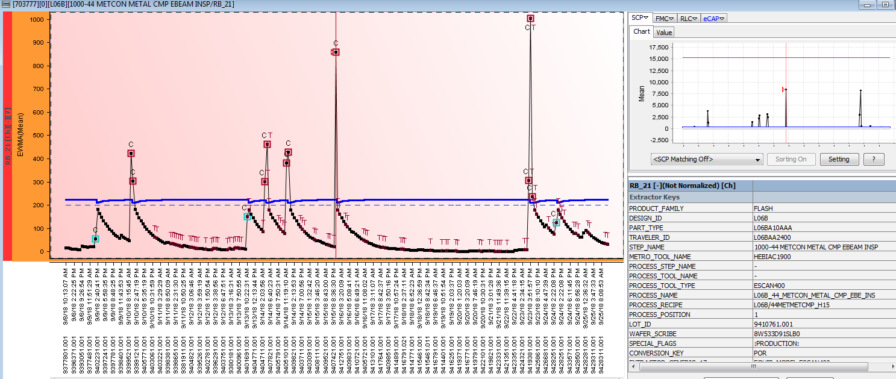
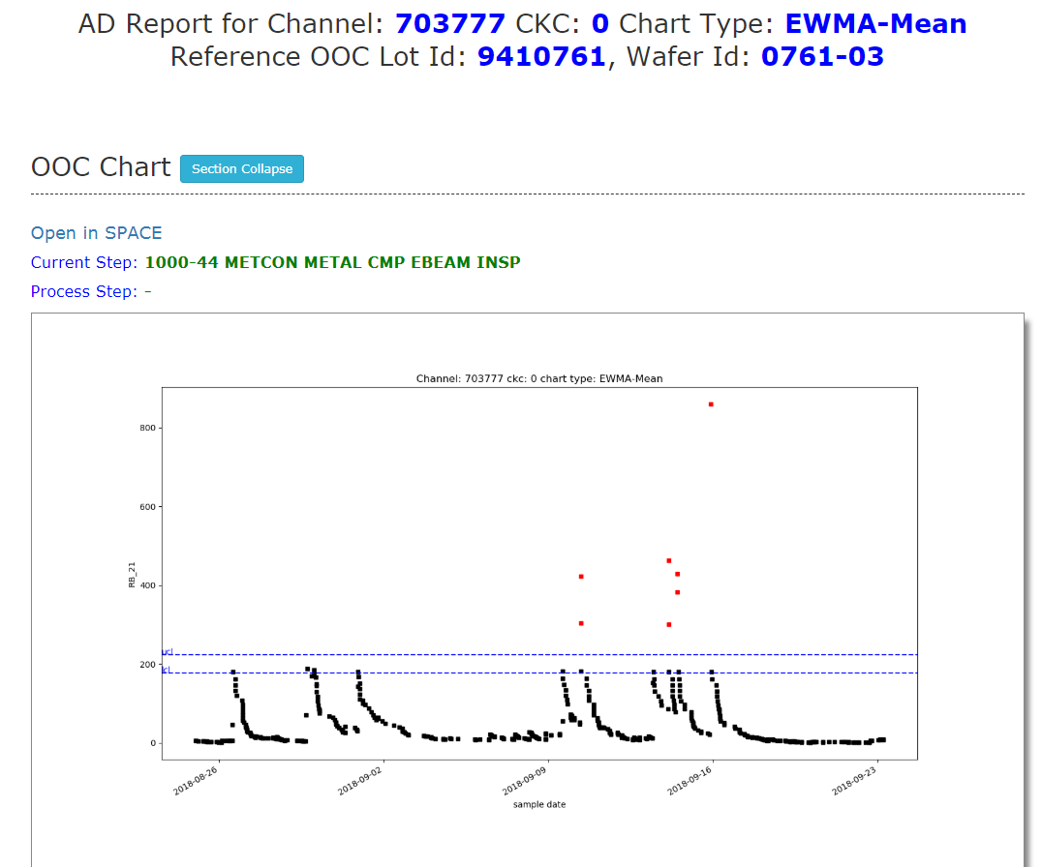
3 data points missing in AD report
This lot is OOC on 9/15
http://fslhdppds01/rda_ad/2018-09-23/10_703777_0_EWMA-Mean_2018092320.html

Slide 8
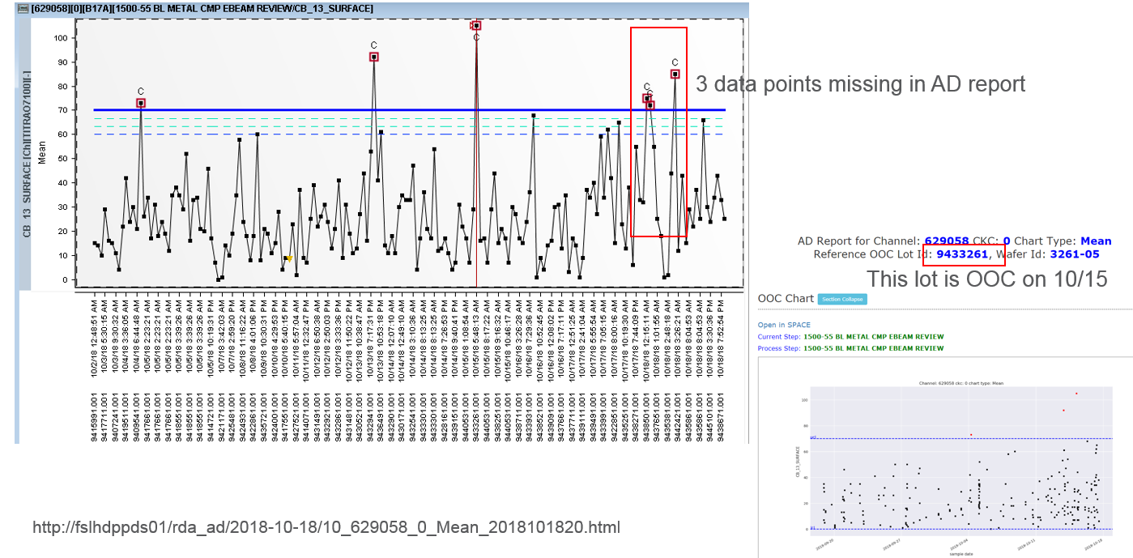

Slide 9
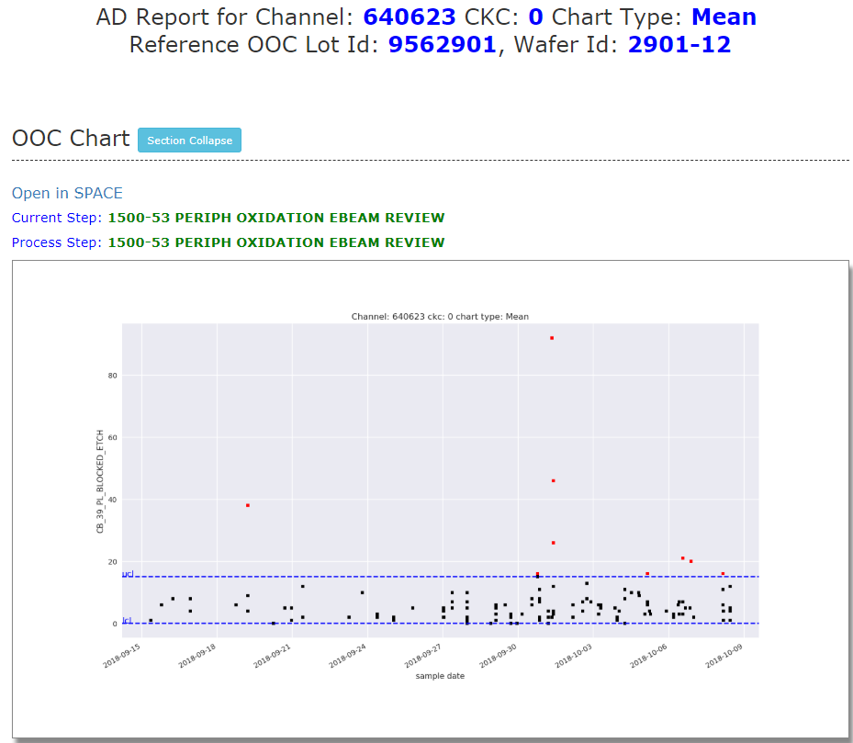
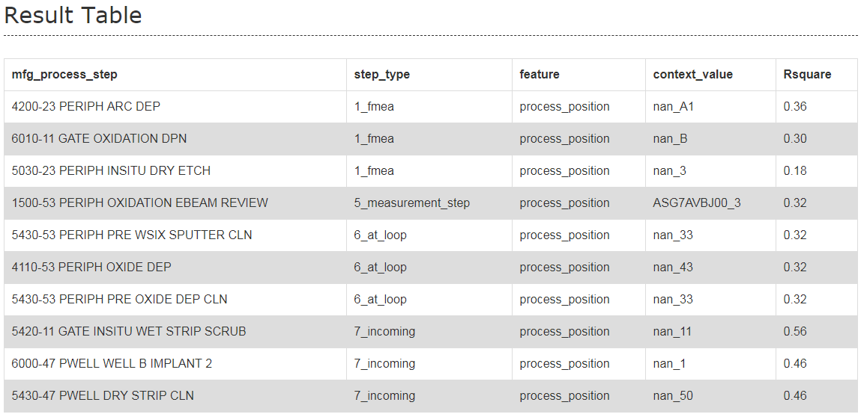


http://fslhdppds01/rda_ad/2018-10-08/10_640623_0_Mean_2018100820.html
Machine data Missing

Slide 10
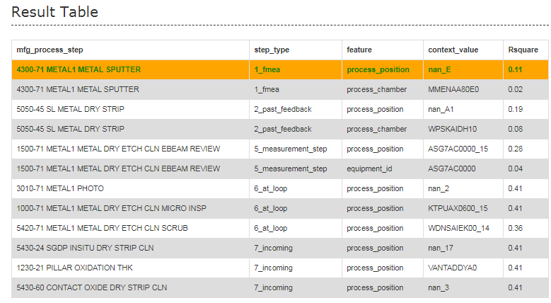
http://fslhdppds01/rda_ad/2018-10-06/10_683052_0_Mean_2018100620.html
Machine data Missing

